Slide 1
Spark Core and Spark SQL
EESHA KAMAL V 22011102117
SRIMITHUN A 22011102104
UDHAYAM 22011102113
SHRIKANTH 2201110099
SANJEETH 2201110091

Slide 2

Topics Covered
Introduction to Apache Spark
Spark Core Fundamentals Spark SQL Overview
Key Features & Comparisons
Agenda
Why is Spark faster than traditional big data tools like Hadoop?
How does in-memory computation improve performance?
https://www.geeksforgeeks.org/components-of- apache-spark/

Slide 3
Introduction to Apache Spark
Apache Spark is a fast, scalable, distributed computing system for big data processing. Uses in-memory computation for speed and lazy evaluation for optimization.
Spark Core handles task execution, while Spark SQL enables SQL-based data analysis. Supports multiple data sources like HDFS, S3, Kafka, and relational databases.
Used in finance, healthcare, e-commerce, and IoT for large-scale analytics.
Why Spark?
Speed – Performs computations 100x faster than Hadoop MapReduce using in-memory processing. Scalability – Runs on clusters with thousands of nodes and petabytes of data.
Flexibility – Supports multiple programming languages (Python, Scala, Java, R).
Unified Framework – Supports batch processing (Spark Core), SQL-based analytics (Spark SQL), stream processing (Spark Streaming), machine learning (MLlib), and graph analytics (GraphX).

Slide 4
W h a t A r e S p a r k C o r e a n d S p a r k S Q L ?
Spark core overview
Foundation of Apache Spark, providing
f o u n d a t i o n o f A p a c h e S p a r k , r e s p o n s i b l e
essential functionalities for distributed
computing.
Supports Resilient Distributed Datasets (RDDs) for parallel data processing.
Ensures fault tolerance through lineage tracking.
Uses lazy evaluation to optimize performance.
Enables parallel computing across a cluster for high-speed data processing.
S p a r k C o r e : T h e
f o r t a s k s c h e d u l i n g , m e m o r y m a n a g e m e n t , f a u l t r e c o v e r y ,
a n d
S p a r k
R D D o p e r a t i o n s .
S Q L : A m o d u l e t h a t
e n a b l e s s t r u c t u r e d p r o c e s s i n g u s i n g S Q L
a n d D a t a F r a m e s , i n t e g r a t i n g e a s i l y w i t h v a r i o u s d a t a
s o u r c e s .
d a t a
q u e r i e s

Slide 5
Key Components of Spark Core
RDDs (Resilient Distributed Datasets)
Immutable, distributed data structures enabling parallel processing. Support lazy evaluation and fault tolerance using lineage tracking.
DAG (Directed Acyclic Graph) Scheduler
Converts Spark jobs into stages and tasks for optimized execution. Ensures efficient task dependencies and fault recovery.
Task Scheduler
Assigns tasks to worker nodes based on resource availability. Works with cluster managers like YARN, Mesos, and Kubernetes.
Storage Layer
Supports multiple file systems: HDFS, S3, local, and more. Caches intermediate data for faster computations.

Slide 6
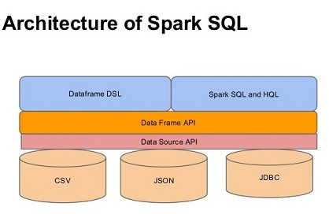
Spark SQL
Module for Structured Data Processing – Enables querying data using SQL within Spark.
Supports Multiple Data Formats – Works with JSON, Parquet, Avro, ORC, Hive, and JDBC sources.
Seamless Integration with RDDs – Allows interaction
between SQL queries and RDDs via DataFrames.
Optimized Execution – Uses Catalyst Optimizer for query optimization and Tungsten Engine for performance improvements.
Interoperability – Works with Hive, BI tools (Tableau, Power BI), and databases (MySQL, PostgreSQL).
text

Slide 7
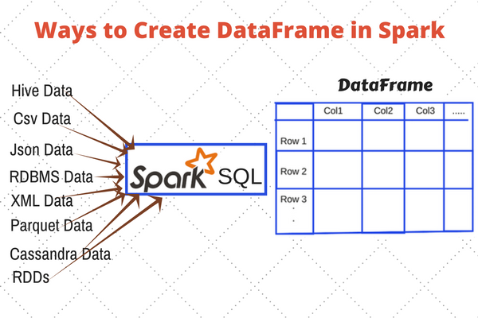
DataFrame in Spark SQL
DataFrames provide a structured way to process data in Spark, replacing traditional RDDs
Why DataFrames?
Faster execution – Uses Catalyst Optimizer and Tungsten Engine.
Schema support – Structured like a table with named columns.
SQL compatibility – Query using Spark SQL. Works with multiple data sources (Hive, JSON, CSV, Parquet, RDBMS, Cassandra, etc.).

Slide 8
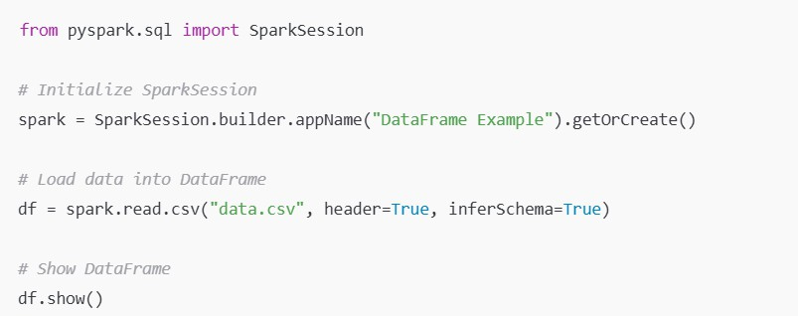
Creating a DataFrame from a CSV file

Slide 9
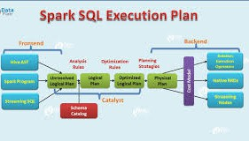
Executing SQL Queries in Spark SQL
Spark SQL allows querying structured data using standard SQL syntax.
Steps to execute SQL queries:
Load data into a DataFrame
Create a temporary SQL view
Run SQL queries on the view

Slide 10
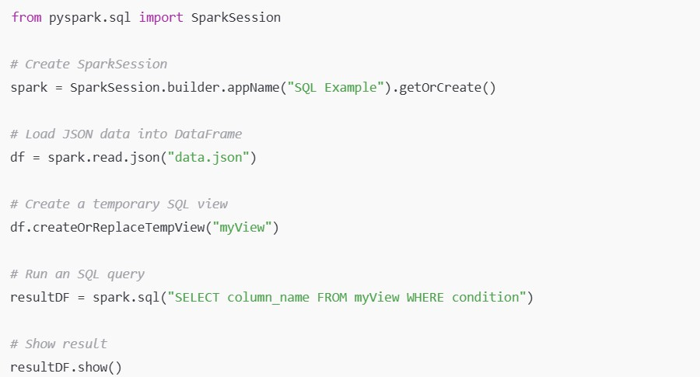
Running SQL Queries in Spark

Slide 11
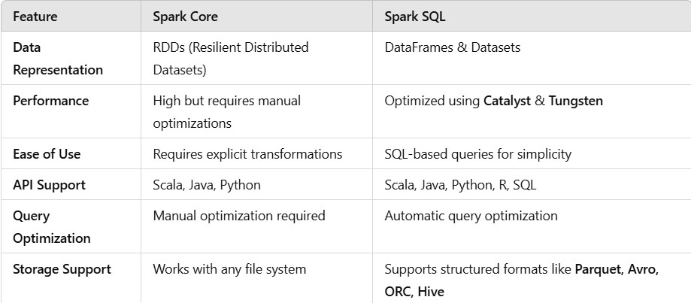
Spark Core vs. Spark SQL

Slide 12
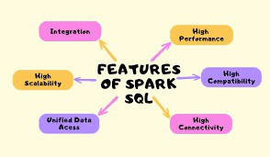
Features of Spark SQL
Spark SQL enhances structured data processing with optimized query execution and integration with various data sources.
Key Features:
Supports Standard ANSI SQL
Optimized Query Execution (Catalyst Optimizer)
Works with Hive and Other Data Sources
Multi-language API Support
Uses Tungsten Engine for Performance
Why Use Spark SQL?
✅ Faster than traditional SQL engines
✅ Handles massive datasets efficiently
✅ Seamless integration with big data tools

Slide 13
Use Cases of Spark Core & Spark SQL
Spark Core Use Cases
✅ Batch Processing – Processing large datasets efficiently.
✅ Log Processing – Analyzing server logs in real-time.
✅ Streaming Analytics – Processing real-time data streams.
✅ Machine Learning – Running ML algorithms on distributed data.
Spark SQL Use Cases
✅ Business Intelligence & Reporting – Running SQL queries on big data.
✅ ETL (Extract, Transform, Load) – Data preprocessing and transformation.
✅ Interactive Analytics – Fast querying for ad-hoc data analysis.
✅ Data Warehousing – Working with structured formats like Parquet & Hive.

Slide 14
Industry Applications
🏦 Finance: Fraud detection, risk analysis.
🏥 Healthcare: Predictive analytics, patient record processing.
🛒 E-commerce: Customer insights, recommendation engines.
🚗 IoT & Smart Cities: Sensor data processing, traffic analysis.
Why Use Spark Core & Spark SQL?
✅ Handles massive datasets efficiently.
✅ Supports real-time and batch processing.
✅ Works with various data formats and sources.

Slide 15
Thank you!

